Slide 1
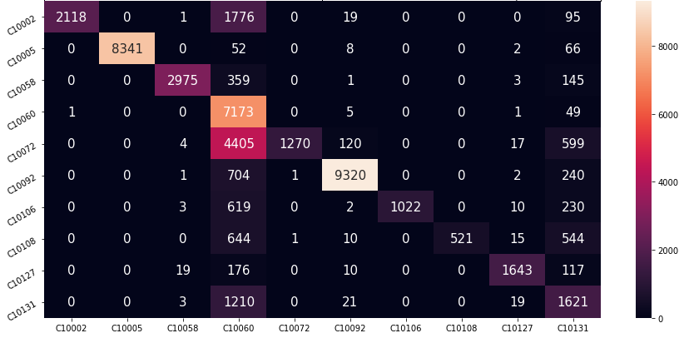
The diagonal represents correct predictions
A lot of records are being misclassified as this class
The colours are related to the record count
Only 1270 out of 6415 (19.7%) are classified correctly
The rows represent the true values
1210 of ‘C10131’s are classified as ‘C10060’s
The columns represent the predicted values

